Slide 1
Chapter 9
Database Design

Slide 2
Learning Objectives
In this chapter, you will learn:
  That successful database design must reflect the information system of which the database is a part
  That successful information systems are developed within a framework known as the Systems Development Life Cycle (SDLC)

Slide 3
Learning Objectives
In this chapter, you will learn:
  That within the information system, the most successful databases are subject to frequent evaluation and revision within a framework known as the Database Life Cycle (DBLC)
  How to conduct evaluation and revision within the SDLC and DBLC frameworks
  About database design strategies: top-down vs. bottom-up design and centralized vs. decentralized design

Slide 4
The Information System
Provides for data collection, storage, and retrieval
Composed of:
  People, hardware, software
  Database(s), application programs, procedures
Systems analysis: Process that establishes need for and extent of information system
Systems development: Process of creating information system

Slide 5
Performance Factors of an Information System
Database design and implementation
Application design and implementation
Administrative procedures
Database development: Process of database design and its implementation

Slide 6
Systems Development Life Cycle (SDLC)
Traces history of an information system
Provides a picture within which database design and application development are mapped out and evaluated
Iterative rather than sequential process

Slide 7
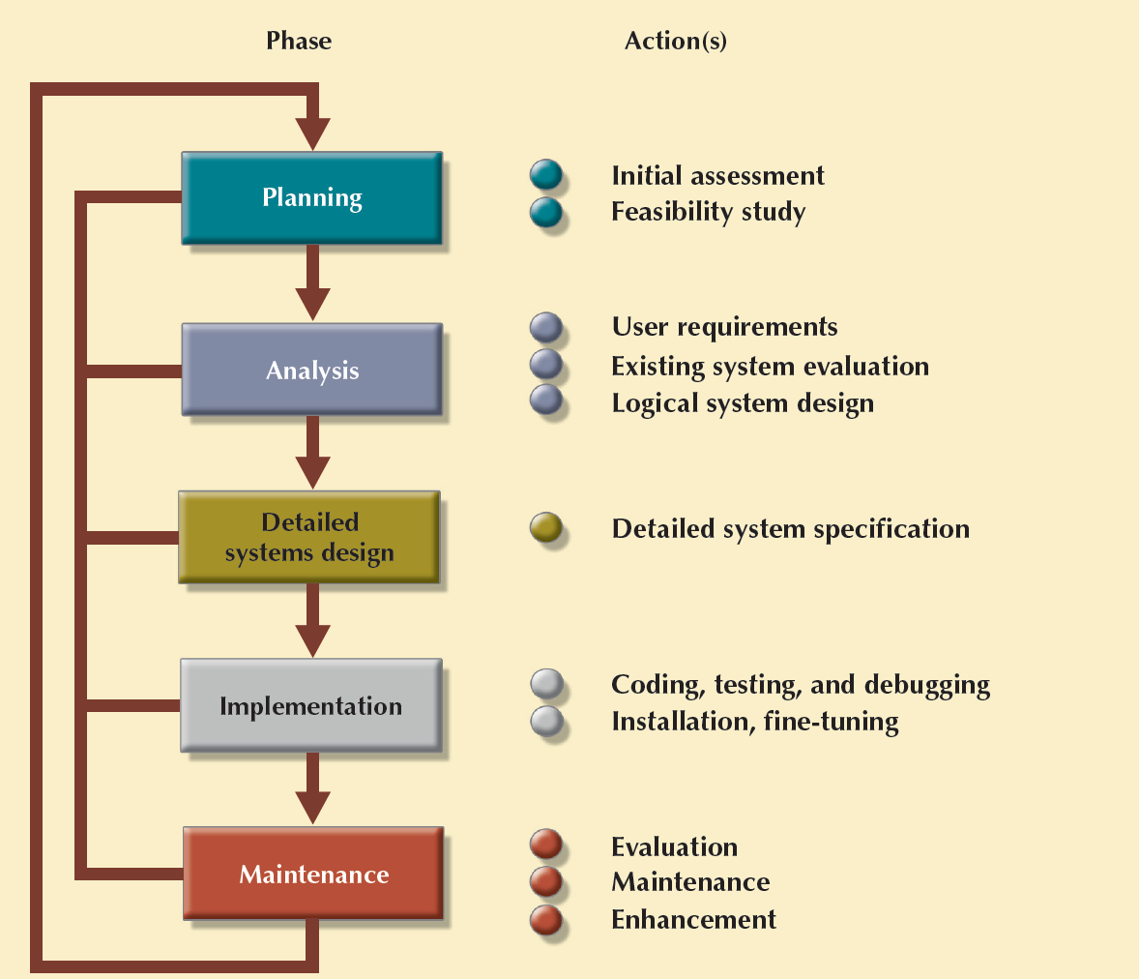
Figure 9.2 - The Systems Development Life Cycle (SDLC)
Cengage Learning © 2015

Slide 8
Computer-Aided Systems Engineering (CASE)
Tool that produces:
  Time and cost effective systems
  Structured, documented, and standardized applications

Slide 9
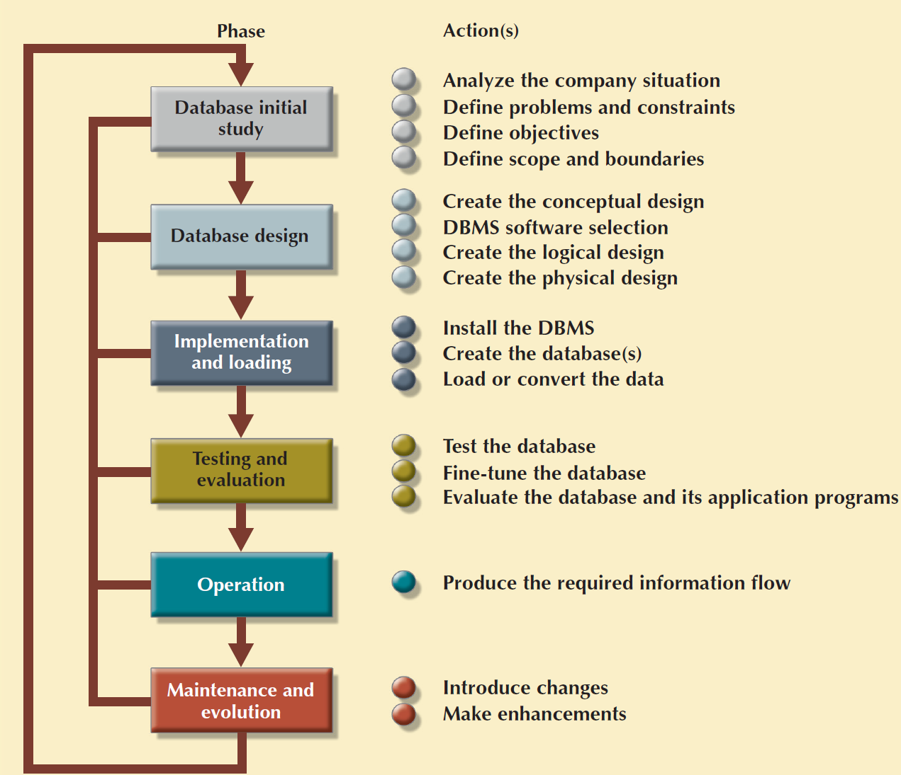
Figure 9.3 - The Database Life Cycle (DBLC)
Cengage Learning © 2015

Slide 10
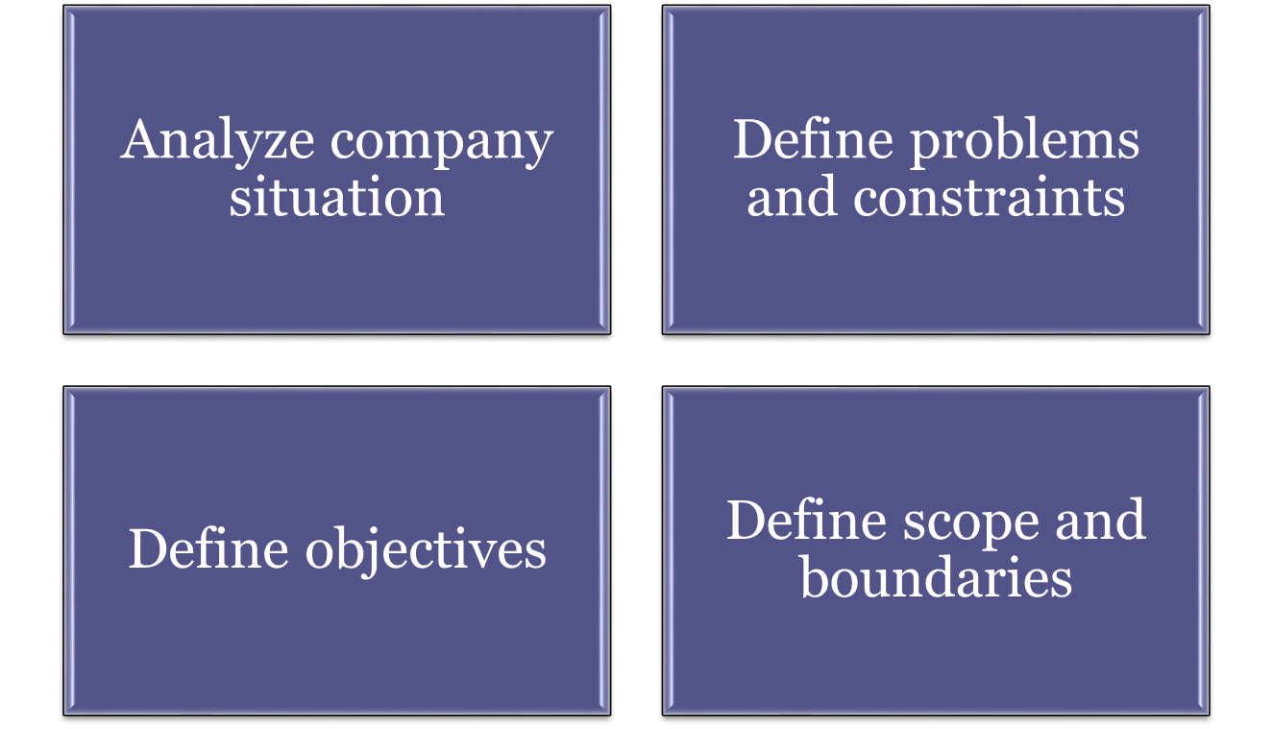
Purpose of Database Initial Study

Slide 11
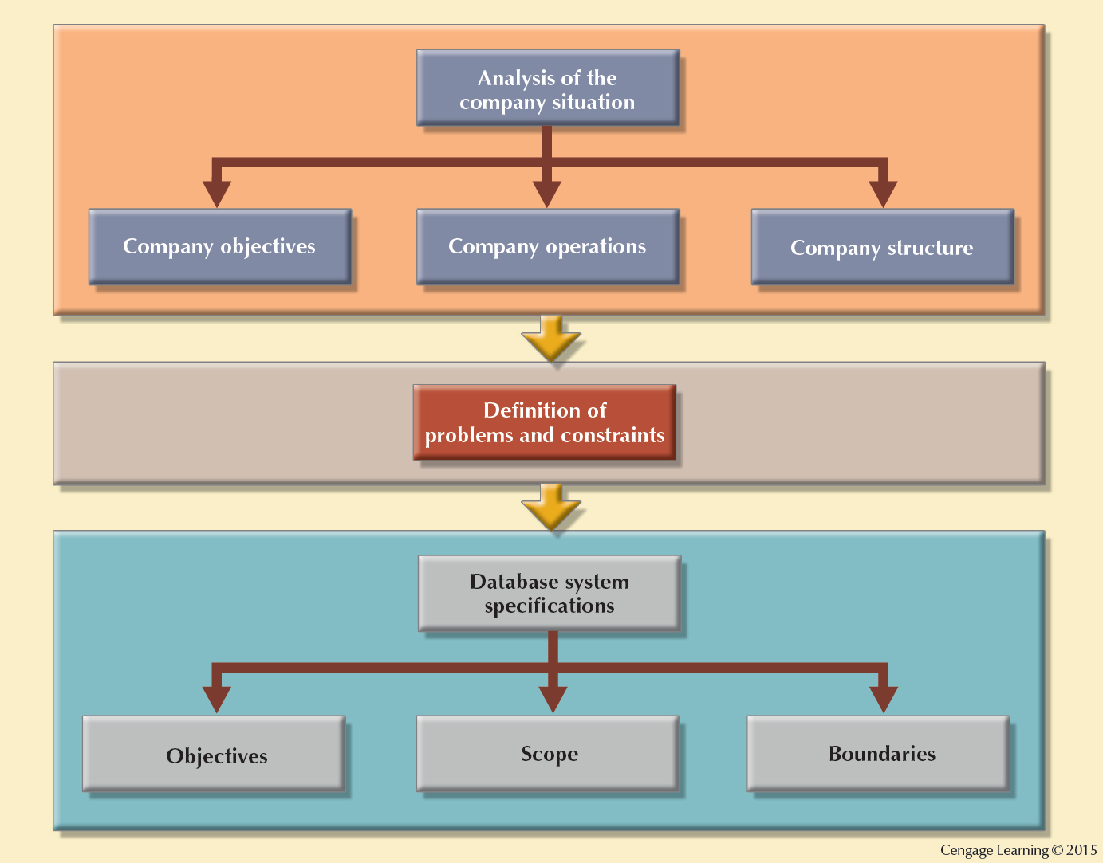
Figure 9.4 - A Summary of Activities in the Database Initial Study

Slide 12
Database Design
Supports company’s operations and objectives
Checks the ultimate final product from all perspectives
Pointers for examining completion procedures
  Data component is an element of whole system
  System analysts/programmers design procedures to convert data into information
  Database design is an iterative process

Slide 13
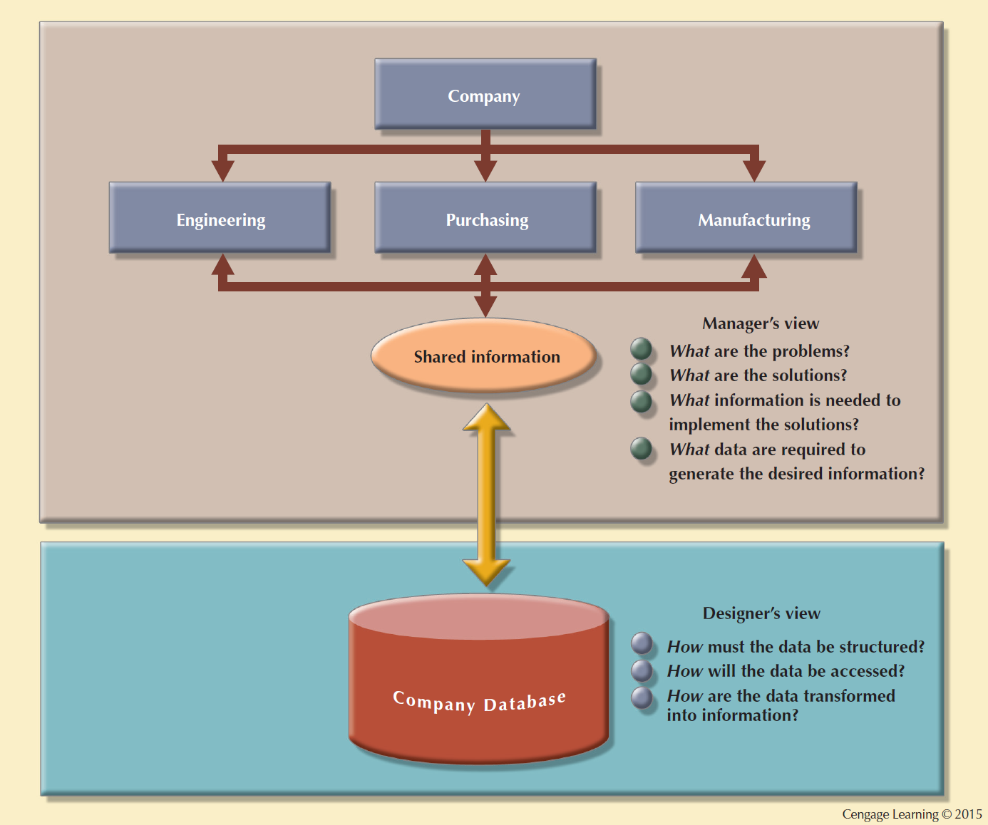
Figure 9.5 - Two Views of Data: Business Manager and Database Designer

Slide 14



Database Design Process
Conceptual
Design
Data analysis and requirements
Entity Relationship modeling and normalization
Data model verification
Distributed database design
DBMS
Selection
Select the DBMS
Logical
Design
Map conceptual model to logical model components
Validate logical model using normalization
Validate logical model integrity constraints
Validate logical model against user requirements
Physical
Design
Define data storage organization
Define integrity and security measures
Determine performance measures

Slide 15
Implementation and Loading
Install the DBMS
  Virtualization: Creates logical representations of computing resources independent of underlying physical computing resources
Create the databases
  Requires the creation of special storage-related constructs to house the end-user tables
Load or convert the data
  Requires aggregating data from multiple sources

Slide 16
Testing Factors
Physical security
Password security
Access rights
Audit trails
Data encryption
Diskless workstations
Optimization

Slide 17
Levels of Database Backups
Full backup/dump: All database objects are backed up in their entirety
Differential backup: Only modified/updated objects since last full backup are backed up
Transaction log backup: Only the transaction log operations that are not reflected in a previous backup are backed up
Backups are provided with high security

Slide 18
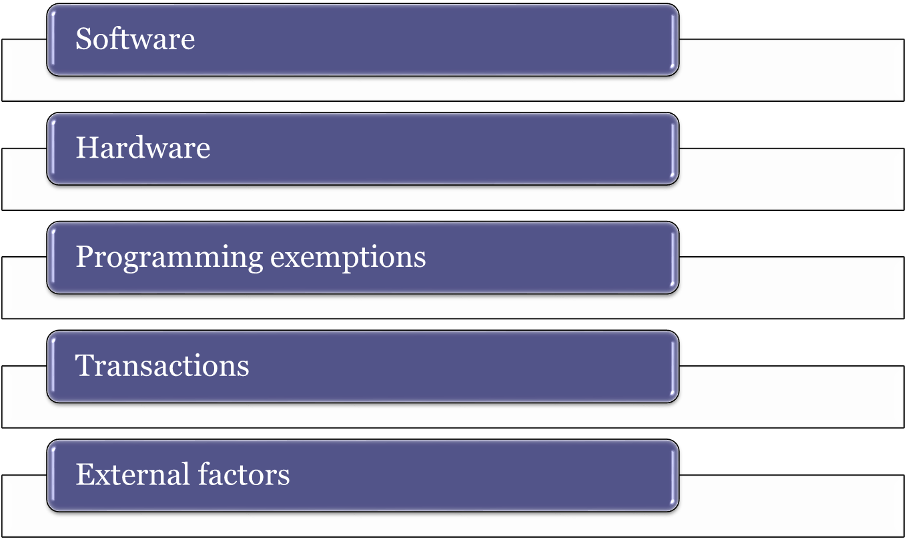
Sources of Database Failure

Slide 19
Periodic Maintenance Activities
Preventive maintenance (backup)
Corrective maintenance (recovery)
Adaptive maintenance
Assignment of access permissions and their maintenance for new and old users
Generation of database access statistics
Periodic security audits
Periodic system-usage summaries

Slide 20
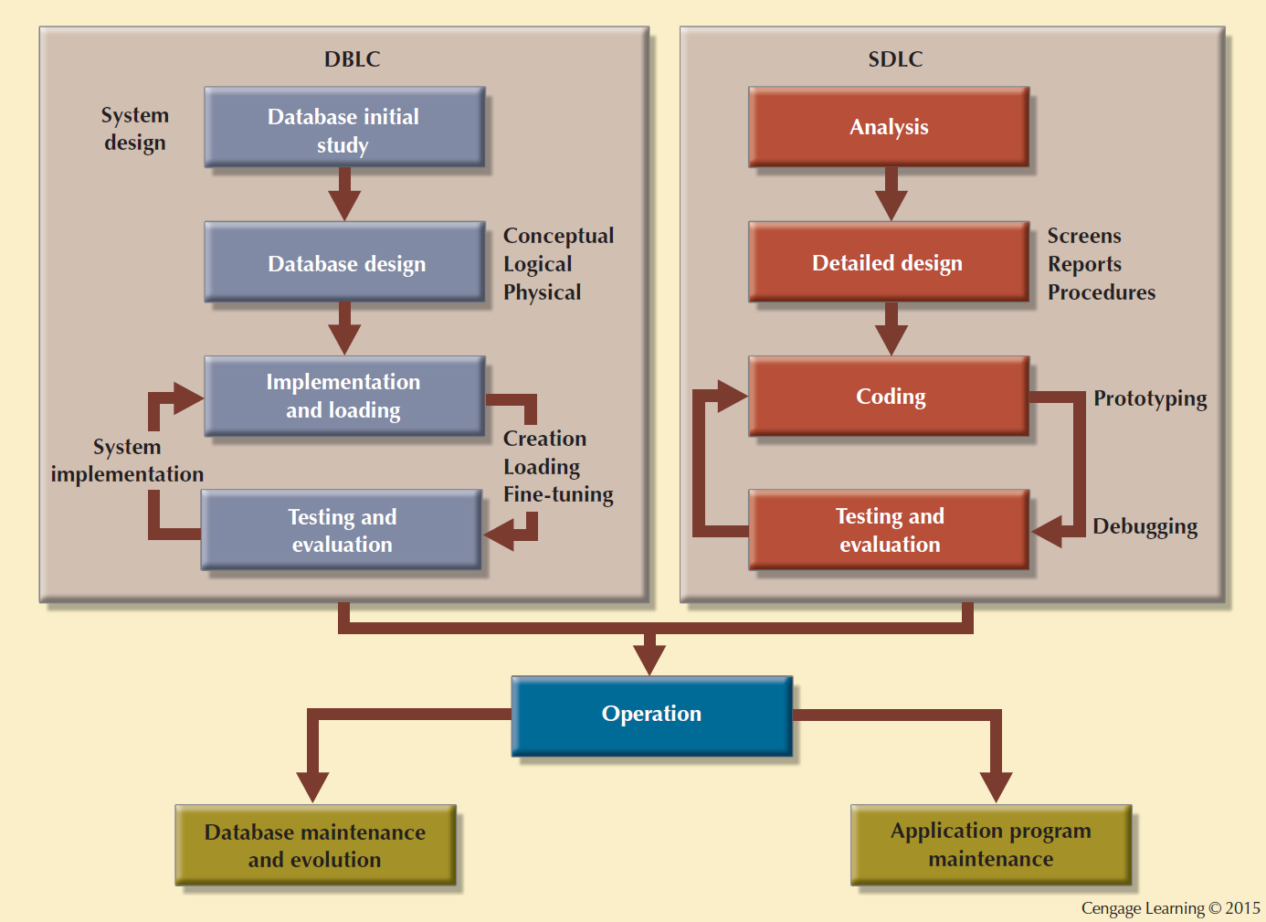
Figure 9.8 - Parallel Activities in the DBLC and the SDLC

Slide 21
Conceptual Design
Designs a database independent of database software and physical details
Conceptual data model - Describes main data entities, attributes, relationships, and constrains
Designed as software and hardware independent
Minimum data rule: All that is needed is there, and all that is there is needed

Slide 22
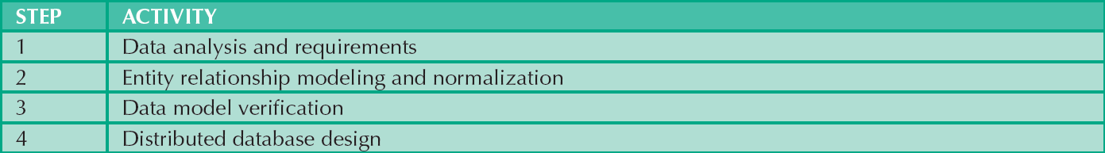
Table 9.2 - Conceptual Design Steps
Cengage Learning © 2015

Slide 23
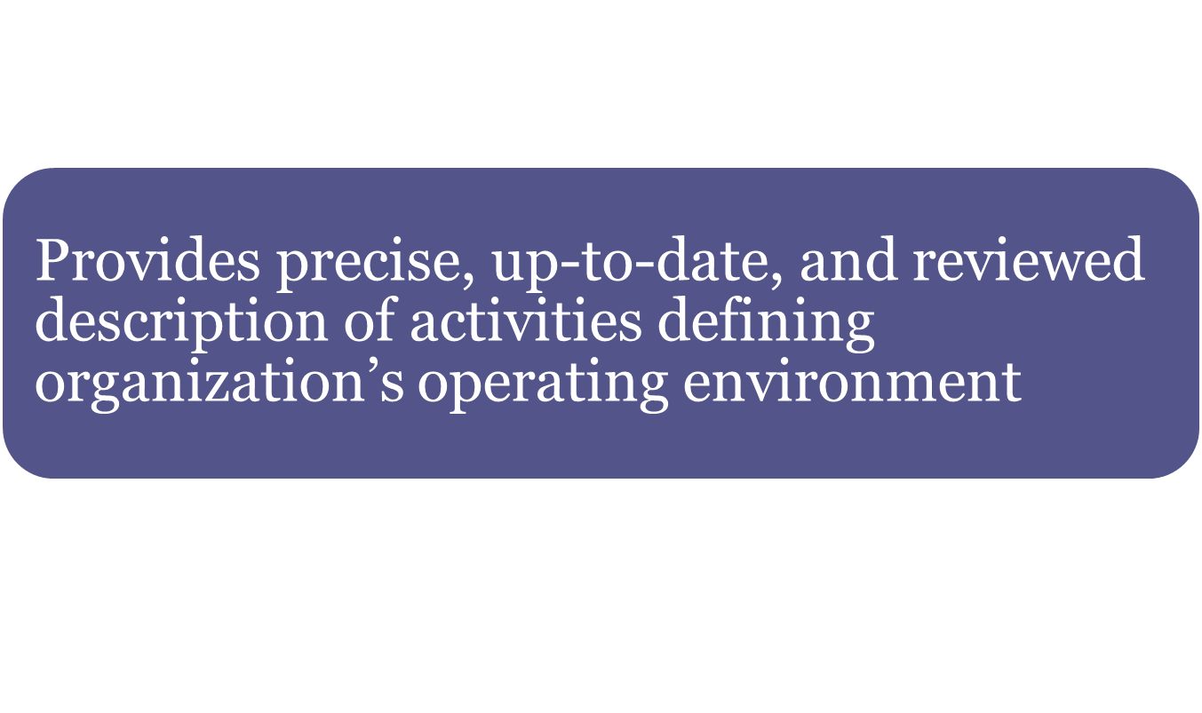
Description of Operations

Slide 24
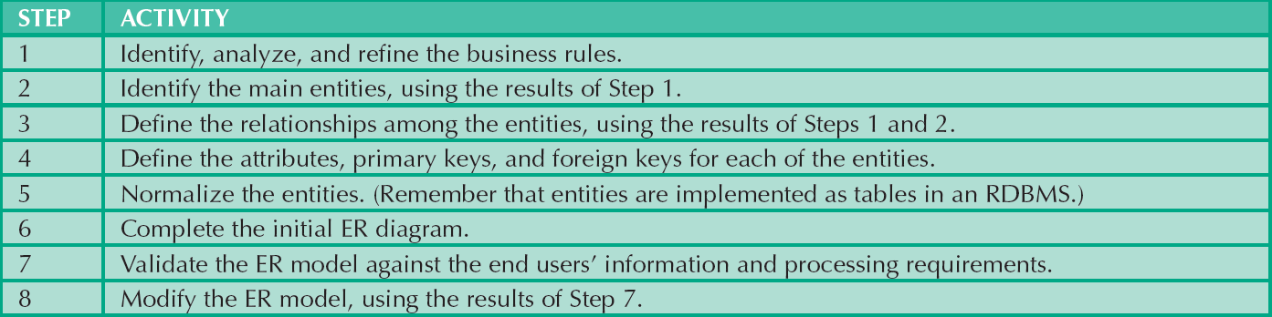
Table 9.3 - Developing the Conceptual Model Using ER Diagrams
Cengage Learning © 2015

Slide 25
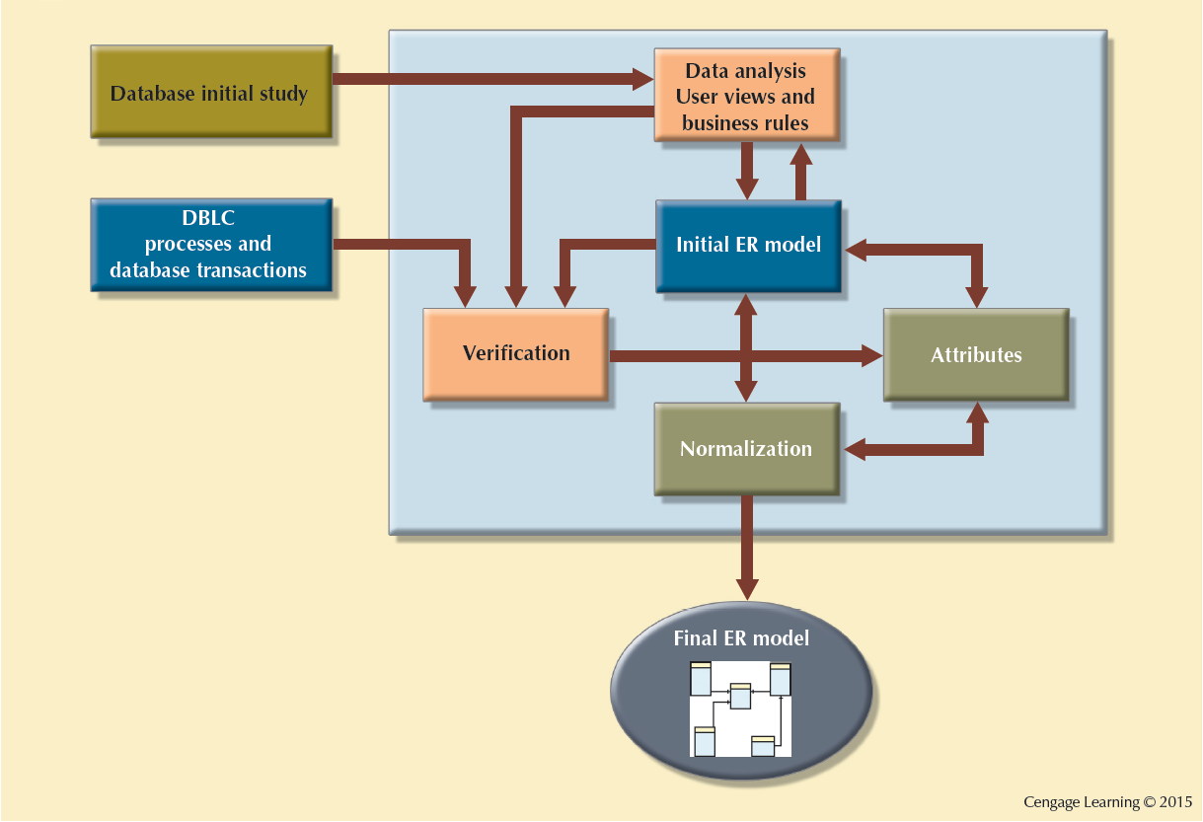
Figure 9.10 - ER Modeling is an Iterative Process Based on Many Activities

Slide 26
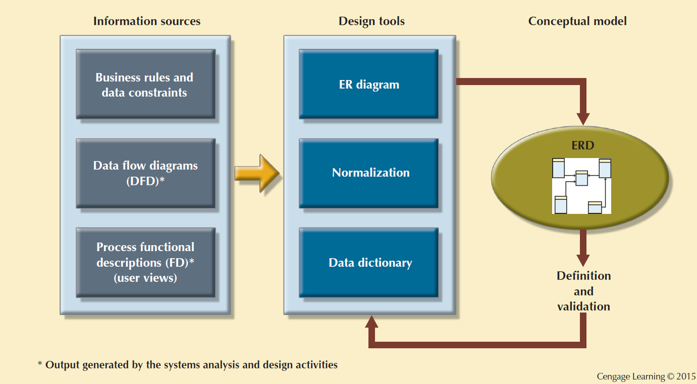
Figure 9.11 - Conceptual Design Tools and Information Sources

Slide 27
Data Model Verification
Verified against proposed system processes
Revision of original design
  Careful reevaluation of entities
  Detailed examination of attributes describing entities
Module: Information system component that handles specific business function

Slide 28
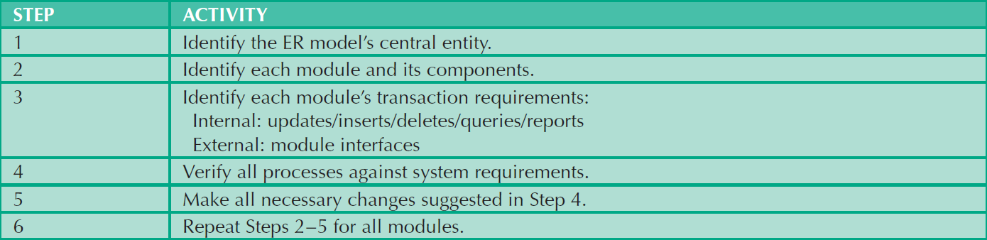
Table 9.5 - The ER Model Verification Process
Cengage Learning © 2015

Slide 29
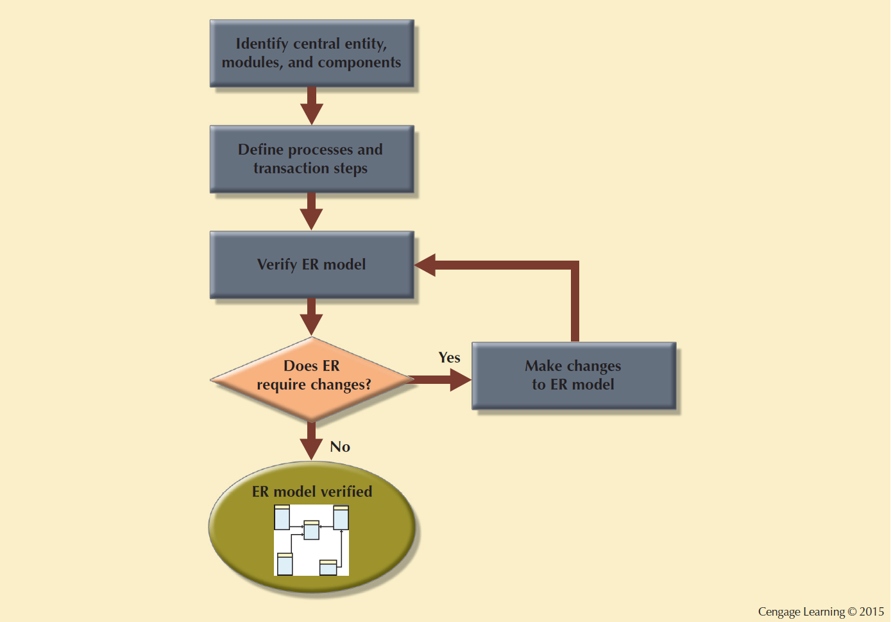
Figure 9.12 - Iterative ER Model Verification Process

Slide 30
Cohesivity and Module Coupling
Cohesivity: Strength of the relationships among the module’s entities
Module coupling: Extent to which modules are independent to one another
  Low coupling decreases unnecessary intermodule dependencies

Slide 31
Distributed Database Design
Portions of database may reside in different physical locations
Database fragment: Subset of a database stored at a given location
Ensures database integrity, security, and performance

Slide 32
Factors Affecting Software Purchasing Decision
Cost
DBMS features and tools
Underlying model
Portability
DBMS hardware requirements

Slide 33
Logical and Physical Design
Logical design: Designs an enterprise-wide database that is based on a specific data model but independent of physical-level details
Validates logical model:
  Using normalization
  Integrity constraints
  Against user requirements
Physical design: Process of data storage organization and data access characteristics of the database

Slide 34

Table 9.6 - Logical Design Steps
Cengage Learning © 2015

Slide 35
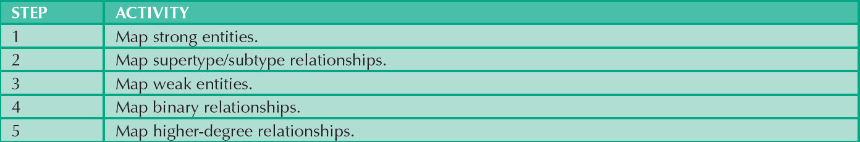
Table 9.7 - Mapping the Conceptual Model to the Relational Model
Cengage Learning © 2015

Slide 36

Table 9.8 - Physical Design Steps
Cengage Learning © 2015

Slide 37
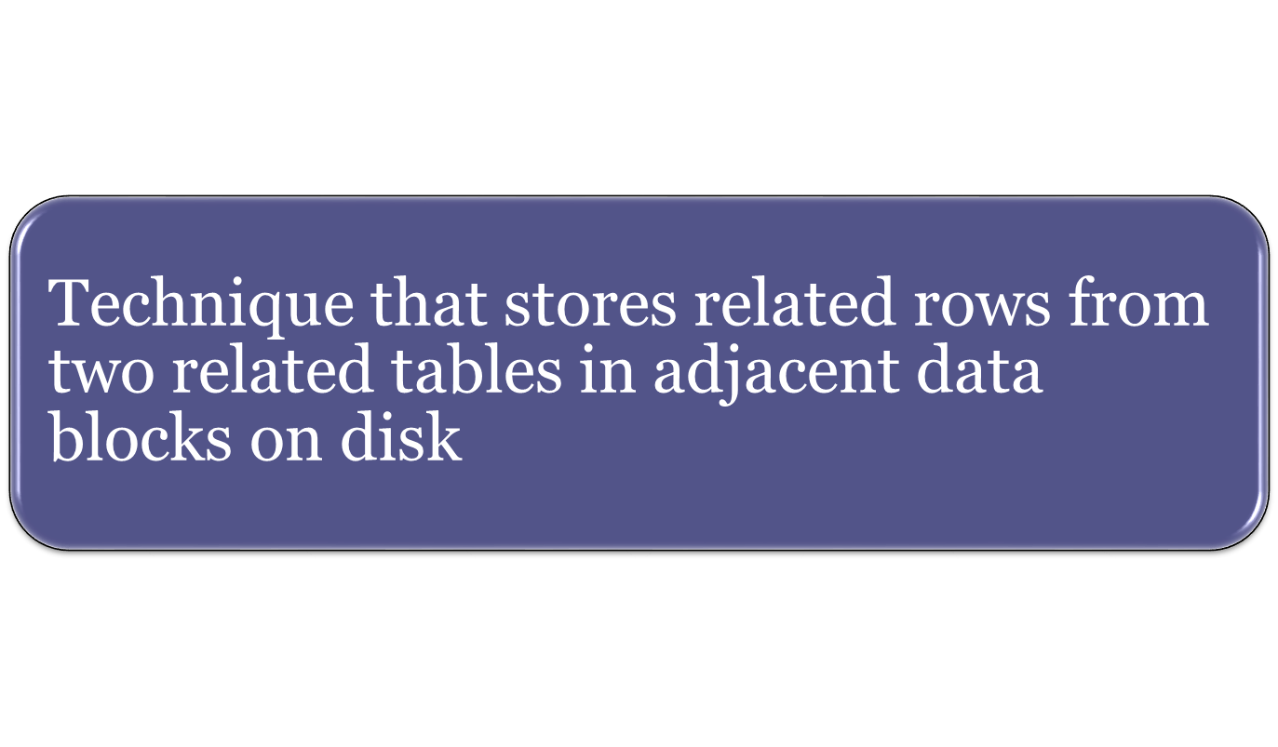
Clustered Tables

Slide 38
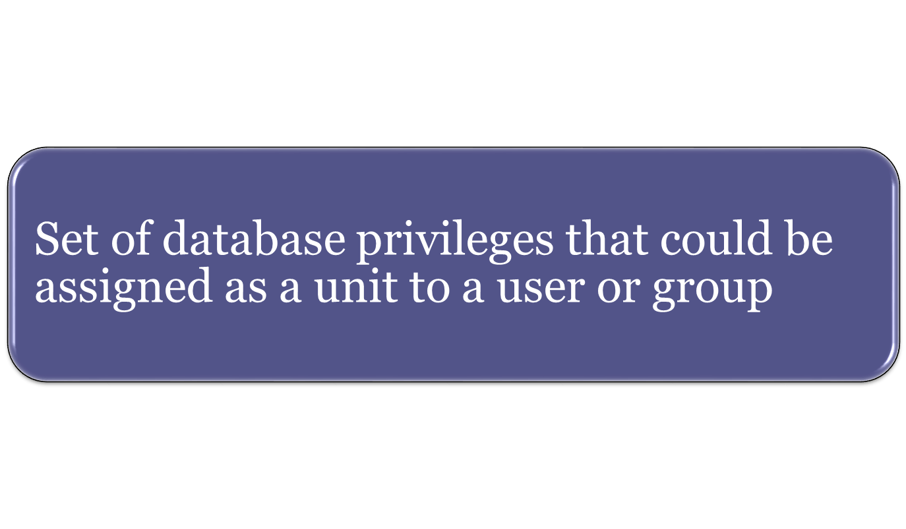
Database Role

Slide 39
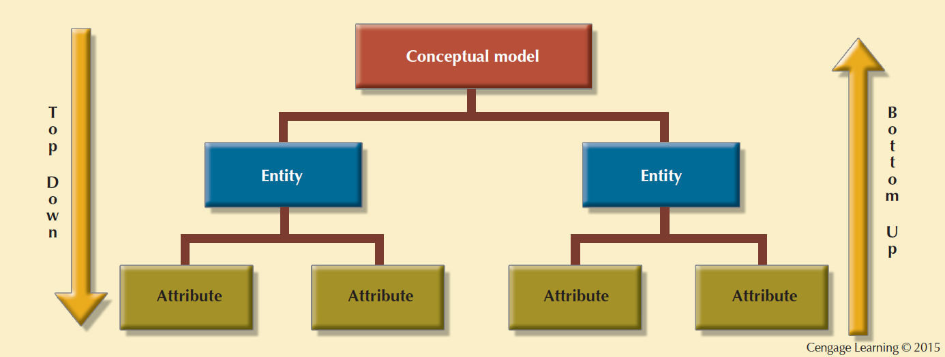
Figure 9.14 - Top-down vs. Bottom-up Design Sequencing

Slide 40
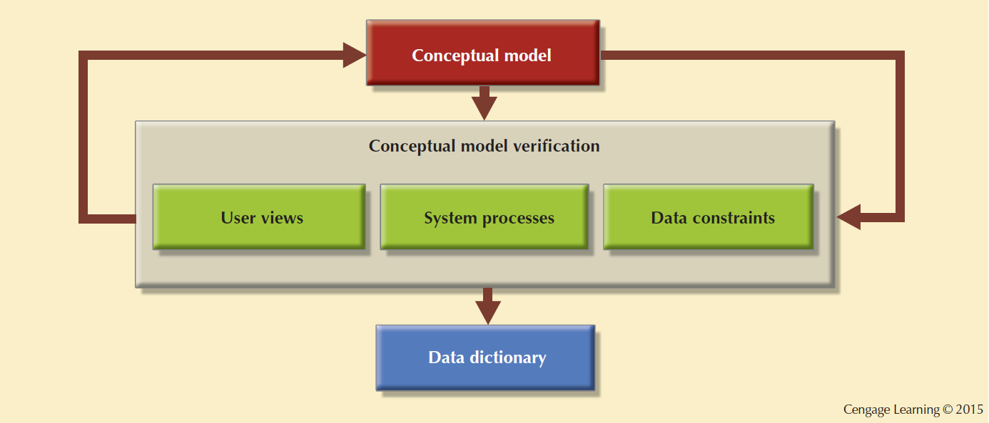
Figure 9.15 - Centralized Design

Slide 41
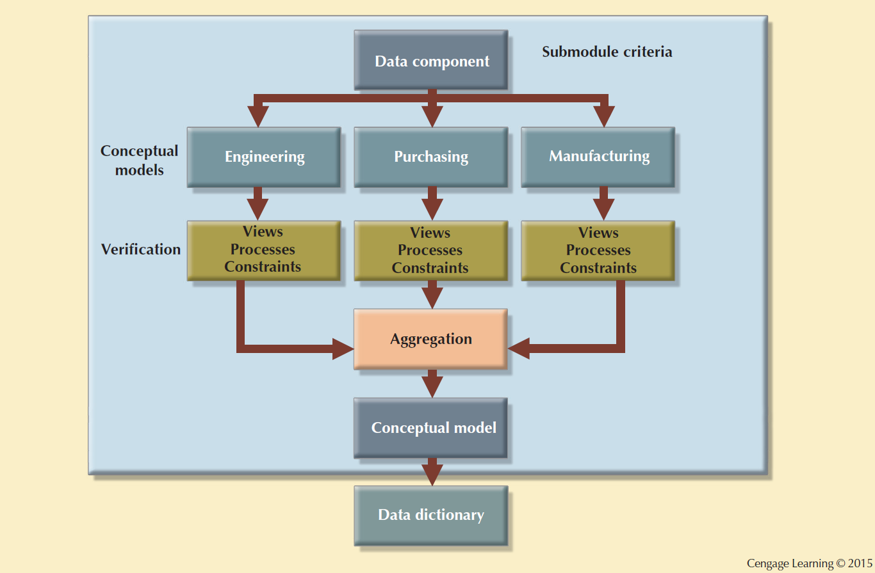
Figure 9.16 - Decentralized Design

Slide 42
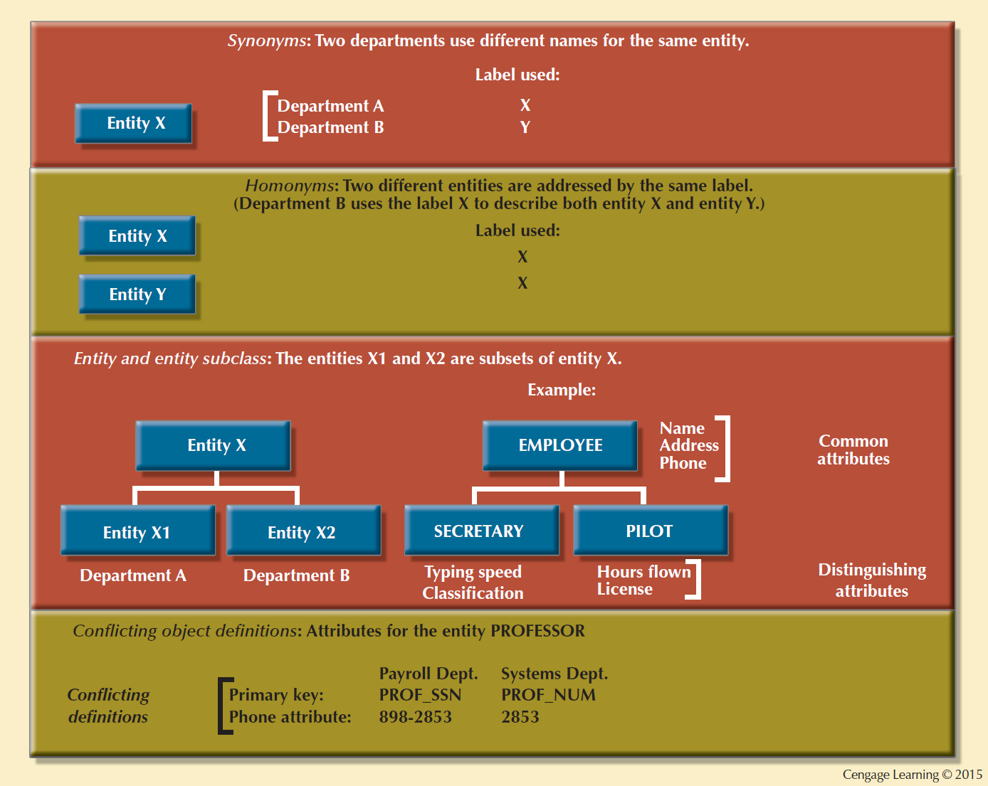
Figure 9.17 - Summary of Aggregation Problems

